Slide 1
Arithmetic for Computers
Continue……

Slide 2
Announcement
Midterm Friday
Time : 6:30 to 8:30
Location : ABB 102
Already posted in avenue

Slide 3
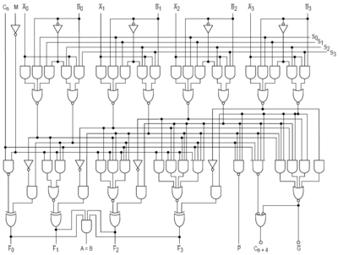
Example: Logic Block

Slide 4
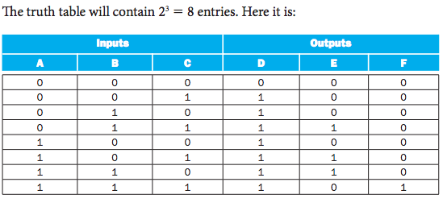
Specify Logic Blocks - 1

Slide 5
Specify Logic Blocks - 2
Boolean Algebra
The OR operator + , e.g, A + B (logical sum)
The AND operator . , e.g., A . B (logical product)
The unary operator NOT Ā

Slide 6


Gates – imp. of basic logic functions
Logic blocks are build form gates
Gates – Are implementations of basic logic functions
AND gates – implementation of AND function
OR gates – implementation of OR functions
NOT gates – implementation of inverse
From left to right

Slide 7
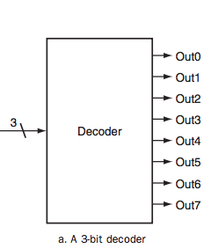
Other Basic Building Elements
Decoder

Slide 8
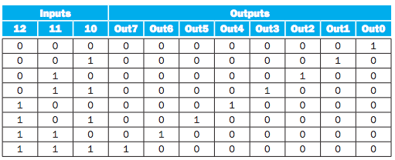
Decoder
Notes:
3 inputs 2^3 = 8 output

Slide 9
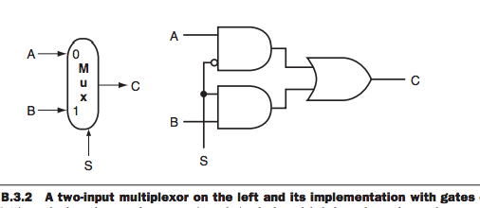
Other Basic Building Elements
Multiplexors
A multiplexor might properly be called as selector
Take several data values and a selector or control
Its output is one of the inputs that is selected by the control
C = (A • S) + (B • S̅)
Example: Two input multiplexor

Slide 10
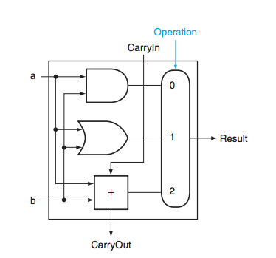
1-bit ALU (AND, OR, Adder)

Slide 11
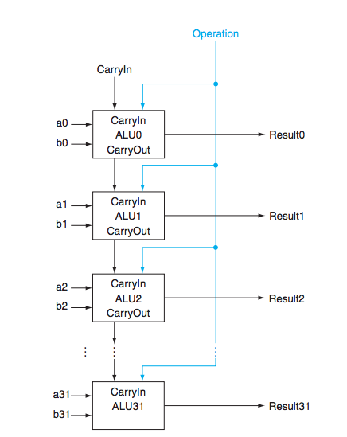
32-bit ALU (Adder)

Slide 12
Constructing an ALU
The arithmetic logic unit (ALU) is the brawn of the computer
The operation is controlled through the ALU Control Lines
000 AND
001 OR
010 Add
110 Subtract
111 Set-on-less-than

Slide 13
ALU - Subtraction
Subtraction is same as adding – (negative) operand
Recall how to get a negative number?
2’s complement
Flip bits (0 -> 1 and 1 -> 0)
Add 1
How can we calculate A –B IN ALU with minor changes?

Slide 14
1-bit ALU (AND, OR, Adder)

Slide 15
ALU – Subtraction with minor changes. How?
Consider adding the following features:
Option of use bitwise NOT A
Option to use bitwise NOT B
Option to use bitwise A XOR B
Option to set 0 as of the first CarryIn
Option to set 1 as of the first CarryIn
What is needed?
1 alone
Both 1 and 2
Both 3 and 4
Both 2 and 5
None of the above

Slide 16
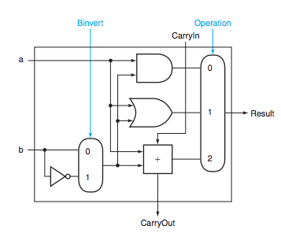
Step – 1
Adding 2:1 multiplexor
Flips the bits

Slide 17
Step - 2
Adding one after complement
a – b = a + complement of (b) + 1

Slide 18
ALU – add, sub, or, and

Slide 19
ALU – set-on-less-than
slt $t0, $t1, $t2
Means
If ($t1 < $t2 )
$t0 = 1
Else $t0 = 0

Slide 20
ALU – set-on-less-than
After the comparison in result register
Least significant would be 0/1
Rest of the bits are 0
a – b < 0
=> a – b + b < b
=> a < b
If a is less than b, a – b is negative
Negative representation has 1 in most significant bit (1)
slt needs
If a is not less than b, a – b is positive
Positive representation has 0 in most significant bit (0)
slt need 0

Slide 21
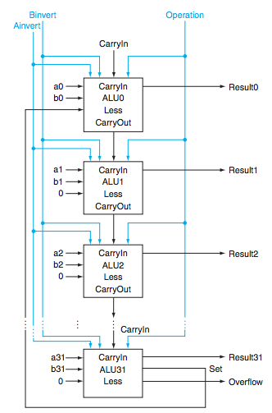
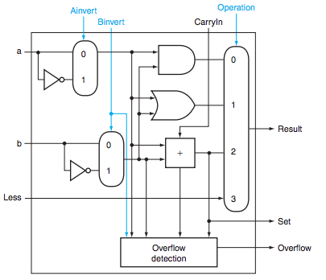

Slide 22
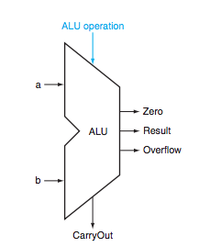
Complete ALU

Slide 23
Practice
How to implement beq

Slide 24
What signals accomplish ADD?
Binvert CarryIn Operator
1 0 2
0 1 2
1 1 2
0 0 2
None of the above

Slide 25
What signals accomplish OR?
Binvert CarryIn Operator
1 0 0
0 1 1
1 1 1
1 0 1
None of the above

Slide 26
What signals accomplish SUB?
Binvert CarryIn Operator
1 0 2
0 1 2
1 1 2
1 0 2
None of the above

Slide 27
What signals accomplish STL?
Binvert CarryIn Operator
1 0 2
0 1 2
1 1 3
0 0 3
None of the above

Slide 28
What we have covered?
Appendix B.5

